Slide 1
Music Elements and Principles

Slide 2
Listen for the Musical Elements: Move if you feel it
Musical Elements: Elementary, My Dear Noah 3:23
https://www.youtube.com/watch?v=q-aoIcJ2_yw&list=PLIJASI0pqGM-745drQPmbZSPn86keZaF0&index=9
Jot down all the musical words you can think of as you are watching and listening….

Slide 3
Vocabulary
Expressive Words to Know
amplify - to make sound “larger”
invigorate - to cause (something) to become more active and lively
rejuvenate - to give new strength or energy to (something)
stir - to move or cause (someone or something) to move after being still
forebode - to have an inward conviction of misfortune

Slide 4
Vocabulary
Expressive Words to Know
incite - to cause (someone) to act in an angry, harmful, or violent way
exhilarate - to cause (someone) to feel very happy and excited
meditate - to spend time in quiet thought
soothe - to cause (someone) to be calmer, less angry, etc
compose - to come together to form or make (something)

Slide 5
I can use advanced art/design vocabulary for responding to the aesthetic qualities of various works ….
Think of 5 more words that would help you express musical compositions.

Slide 6
Music is...
•A beautiful sound
•Something that makes people feel comfortable
•Wonderful sounds of rhythm
•Beats mixed together to make a song
•Entertainment
•Sounds made by instruments
•A thing that portrays culture and creativity

Slide 7
Definition
•music n.1.The art of arranging sounds in time so as to produce a continuous, and unified composition through melody, harmony, rhythm, and timbre. Also having the ability to bring a memory, mood, or image to mind.

Slide 8
Lyrics and Score
Lyrics are the words of a song
Score is the music

Slide 9
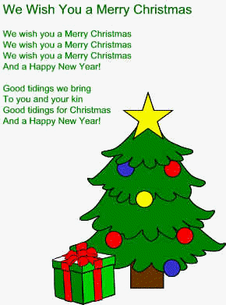
Lyrics Example

Slide 10
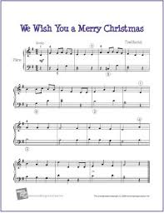
Score Example

Slide 11
Elements
Elements = core components;
The pieces that we use to build music
•Duration
•Intensity
•Pitch
•Timbre

Slide 12
Duration
Duration - The length of something.
Examples:
quarter note = 1 beat
half note = 2 beats
whole note = 4 beats
phrase = 4 measures
Beyonce - “Halo” lasts 3 minutes and 45 seconds

Slide 13
Intensity
Intensity - The strength of something
Results from the following:
Personality - general feeling (ominous, perky, powerful, etc)
Heat - passion behind the lyrics and score
Volume - how loud the music is

Slide 14
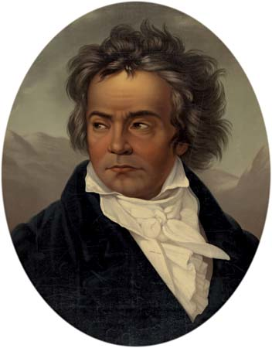
Intensity with Beethoven
https://www.britannica.com/biography/Ludwig-van-Beethoven/images-videos
Low Intensity:
“Moonlight Sonata”
The opening measures of Ludwig van Beethoven’s Piano Sonata in C-sharp Minor,…
High Intensity:
Beethoven, Ludwig van: Symphony No. 5 in C...
Excerpt from the first movement, “Allegro con brio,” of Beethoven’s Symphony...

Slide 15
Contemplate & Collaborate
What effect does intensity have on the theme of a song?

Slide 16
Pitch
Pitch is the Highness or
lowness of a sound

Slide 17
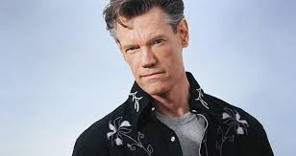
Example: Pitch
High Pitch
Mariah Carey
“Emotions”
Low Pitch
Randy Travis
“Deeper Then the Holler”
https://www.youtube.com/watch?v=QE5Cr5hdf4I
https://www.youtube.com/watch?v=Ffo3yKFjYmA

Slide 18
Contemplate & Collaborate
How do pitch and intensity work together to create an overall sound?

Slide 19
Timbre (pronounced tamber)
the character or quality of a musical sound or voice as distinct from its pitch and intensity.
In simple terms, timbre is what makes a particular musical sound different from another, even when they have the same pitch and loudness. For instance, it is the difference between a guitar and a piano playing the same note at the same loudness

Slide 20
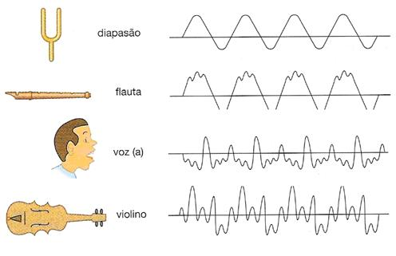
Video Definition
https://www.youtube.com/watch?v=144QVYv__S4
https://www.youtube.com/watch?v=5tGEDgkZlC8

Slide 21
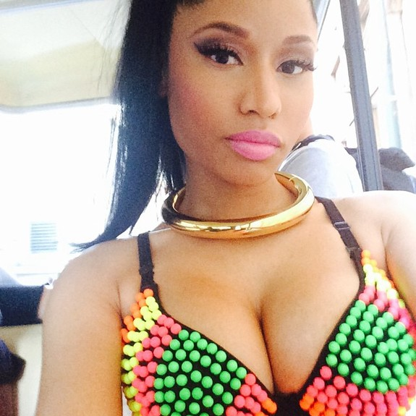
Contemplate & Collaborate
Why can’t Ms. Teacher sound exactly like Nicki Minaj even when she matches her notes perfectly?
?

Slide 22
Principles
Principles = Basic qualities that determine characteristics.
What we do/create with the elements.
Composition Harmony
Form Rhythm
Genre Texture

Slide 23
Composition
•The activity or process of creating music.
–The end result of such an activity

Slide 24
Form
•The shape or structure of something.
–The way that music is organized

Slide 25
Example - Form
“Twinkle, Twinkle Little Star” The form is a rhyme pattern of AABB
Twinkle, twinkle little star
How I wonder what you are
Up above the world so high
Like a diamond in the sky
Twinkle, twinkle little star (A)
How I wonder what you are (A)
Up above the world so high (B)
Like a diamond in the sky (B)

Slide 26
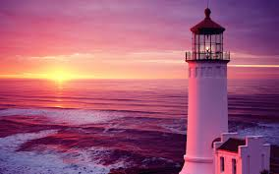
Example: Form
Cyclical form occurs when a song starts at a low intensity then builds to a high intensity then settles for a low intensity at the end.
Nickel Creek
“I Am the Lighthouse”
https://www.youtube.com/watch?v=1Pvf9kkoi4k

Slide 27
Important to Note
Not every song is cyclical. Not every song follows the same form.
Form is simply
HOW THE SONG IS ORGANIZED.

Slide 28
Genre
•A certain type or category of something.

Slide 29
Examples - Genre
https://www.youtube.com/watch?v=A_ZatuoalP0

Slide 30
Harmony
•Two or more pitches/notes played at the same time to create chords.

Slide 31
Example - Harmony
Nelly Furtado
“I’m Like a Bird”
https://www.youtube.com/watch?v=2vHH2pOzuMA

Slide 32
Rhythm
•Grouping of musical sounds by duration and intensity

Slide 33
Example - Rhythm
Sugar Hill Gang
“Rapper’s Delight”
https://www.youtube.com/watch?v=mcCK99wHrk0

Slide 34
Texture
•The way something feels; the mood of music

Slide 35
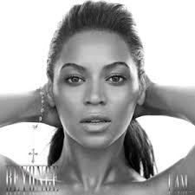
ThinkPairShare
Use your vocabulary words to describe the texture of the song.
Beyonce
“Halo”
https://www.youtube.com/watch?v=VyR7yoDBQSg

Slide 36
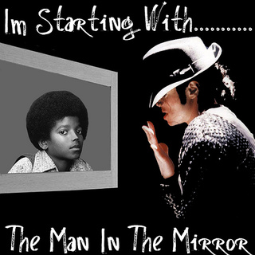
Dependent Practice
Listen to the following song and apply the elements and principles in complete sentences.
Michael Jackson’s
“Man in the Mirror”
Lyrics
https://www.youtube.com/watch?v=P5vz6iwV38U
Official Video
https://www.youtube.com/watch?v=PivWY9wn5ps

Slide 37
Connecting Music to Dance
Movie stars dancing to “Uptown Funk”
https://www.youtube.com/watch?v=M1F0lBnsnkE

