Slide 1
Ancient Greek And Roman art

Slide 2
Vocabulary

Slide 3
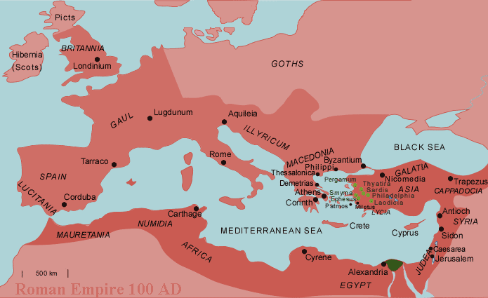
Classical-the art of ancient Greece and Rome

Slide 4
stylized - represented in a non-naturalistic conventional form.
Anatomical - of or relating to bodily structure

Slide 5
Realism - the quality or fact of representing a person, thing, or situation accurately or in a way that is true to life.
Idealism - literary or artistic theory or practice that encourages the value of imagination above the faithful copying of nature

Slide 6
archaic - of an early period of art or culture, especially the 7th–6th centuries BC in Greece
Kouros - an archaic Greek statue of a young man, standing and often naked
Kore - an archaic Greek statue of a young woman, standing and clothed in long loose robes

Slide 7
Contrapposto - in the visual arts, the standing human figure is poised so that the weight rests on one leg (called the engaged leg), freeing the other leg, which is bent at the knee. With the weight shift, the hips, shoulders, and head tilt, suggesting relaxation and a natural pose .

Slide 8
Architecture - the art or practice of designing and constructing buildings
Aqueduct - an artificial channel for conveying water, typically in the form of a bridge supported by tall columns across a valley.

Slide 9
Mural - a painting or other work of art executed directly on a wall.
Fresco - a painting made onto wet or dry plaster
Mosaic - Tiles called tesserae placed into wet cement or grout. Roman tiles were usually made of marble, pebbles, and other stones.

Slide 10
Propaganda - information, especially of a biased or misleading nature, used to promote or publicize a particular political cause or point of view

Slide 12
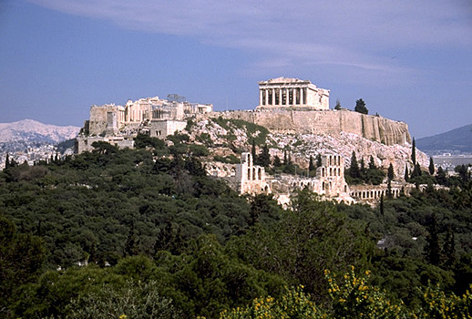
Culture, Religion, and Art
The Greeks believed in living the perfect life. They believed that a variety of different gods (Greek Mythology) controlled different aspects of every person’s destiny on earth. They believed these gods acted in very human ways. The Greeks had great respect and fear for them.
As a result, many buildings and works of art were created to please the different gods and give the Greek people places to worship.
The Parthenon
Acropolis

Slide 13
Culture, Religion, and Art
Acropolis
A sacred hill in Athens, Greece that rises some 500 feet above the surrounding city. It is covered with buildings, temples, and statues. It was intended to be a tribute to the gods and placed high on the land so they could be closer to the gods.
It was also intended to symbolize the glory and power of Athens to those that approached.
The Parthenon
One of the Greeks greatest contributions was in architecture. An example of this would be the Parthenon. It took 10 years to build this massive structure that sits atop the Acropolis. Its purpose was to house a massive statue of Athena (which no longer survives today).
The Parthenon
Acropolis

Slide 14
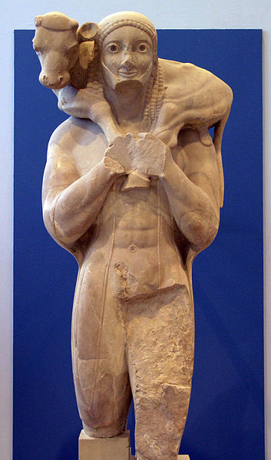
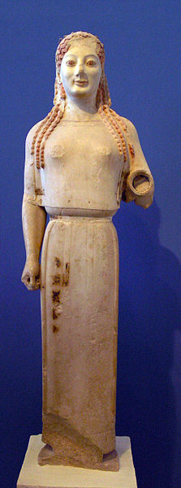
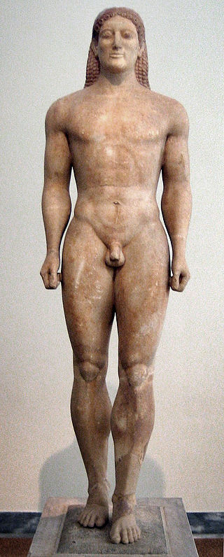
Archaic Style – Ancient Greek, (600 - 480 B.C.)
19
4
20
Notes:
#20 – The Kroisos Kouros, in Parian marble, found in Anavyssos (Greece), dating from circa 530 BC, now exhibited at the National Archaeological Museum of Athens. - public domain - https://en.wikipedia.org/wiki/Kouros#mediaviewer/File:Kouros_anavissos.jpg
#4 - The Moschophoros or Calf-bearer - circa 570 BC - Photo by Marsyas - https://en.wikipedia.org/wiki/File:ACMA_Moschophoros.jpg

Slide 15
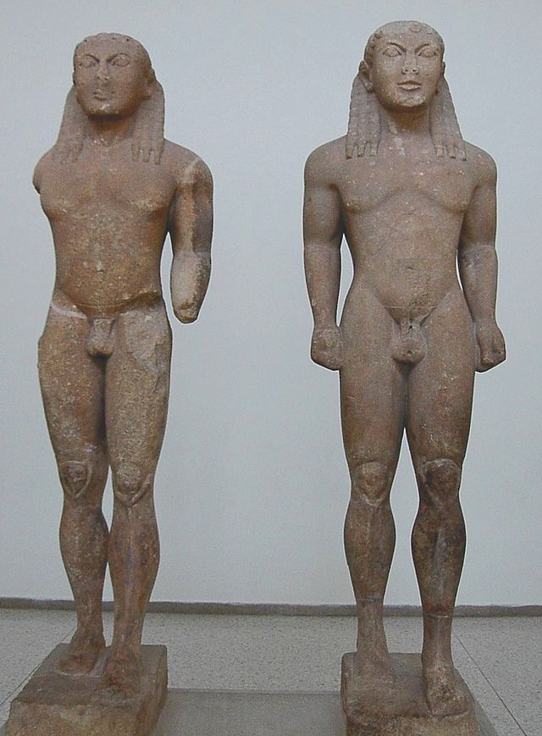
Archaic Style – Ancient Greek, (600 - 480 B.C.)
Archaic Style – Ancient Greek, (600 - 480 B.C.)
“stylized geometry” and rigid symmetry from Ancient Egyptian roots
Stiff and unnatural, but with universal man with ideal beauty
Stylized hair and “Archaic smile”
14
Kouros (male), Kore (female)
Notes:
#14 – Kleobis and Biton, kouroi of the Archaic period, c. 580 BCE. Held at the Delphi Archaeological Museum - public domain - https://en.wikipedia.org/wiki/Ancient_Greek_sculpture#mediaviewer/File:Ac.kleobisandbiton.jpg
#19 – Peplos Kore - Photo by Marsyas - https://en.wikipedia.org/wiki/File:ACMA_679_Kore_1.JPG,

Slide 16
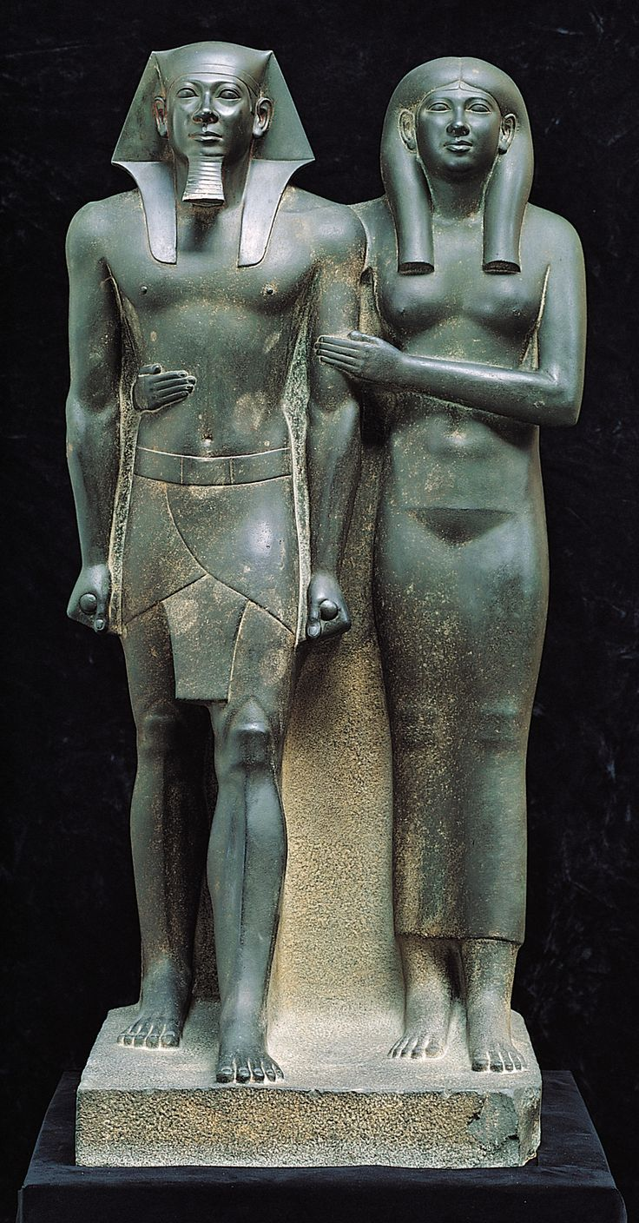
Contemplate then Collaborate: Compare and contrast, describe the similarities and differences in the archaic style Greek statue (left) and the Egyptian statue (right).

Slide 17
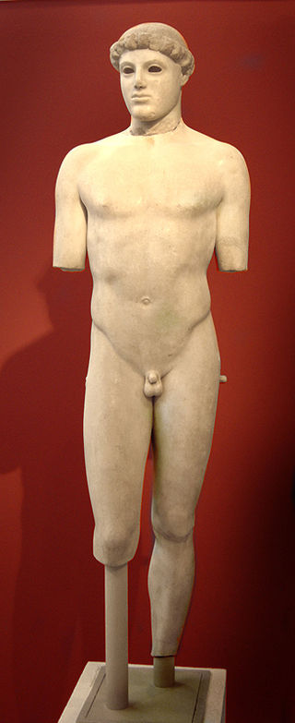
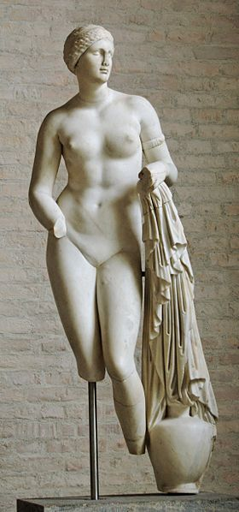
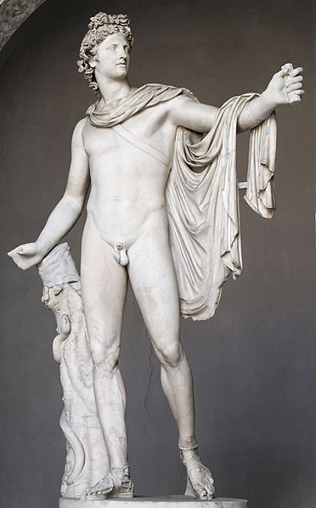
Classical Style – Ancient Greek, (480 - 323 B.C.)
9
15
8
Notes:
8 - Kritios Boy. Marble, c. 480 BC. Acropolis Museum, Athens. – Photo by Tetraktys - https://en.wikipedia.org/wiki/Kritios_Boy#mediaviewer/File:009MA_Kritios.jpg
15 - Leochares: Belvedere Apollo. Roman copy of 130–140 AD after a Greek bronze original of 330–320 BC. Vatican Museums – public domain - https://en.wikipedia.org/wiki/File:Belvedere_Apollo_Pio-Clementino_Inv1015.jpg

Slide 18
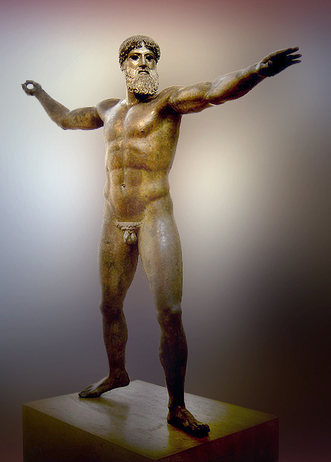
Classical Style – Ancient Greek, (480 - 323 B.C.)
Classical Style – Ancient Greek, (480 - 323 B.C.)
Universal man
Natural contrapposto/weight shift pose with s-curve
Lifelike and naturalistic figures, but with idealized youth, beauty, and perfect proportions
2
Active poses yet calm and controlled facial expressions
balance between the mind and the body
Notes:
2 - The Artemision Bronze (National Archaeological Museum of Athens). – Photo by Ricardo André Frantz (User:Tetraktys)
9 - So-called “Aphrodite Braschi”, free copy (1st century BC) after a votive statue of Praxitele in Cnidus (“Aphrodite of Cnidus” type, ca. 350–340 BC). – public domain - https://en.wikipedia.org/wiki/File:Aphrodite_Braschi_Glyptothek_Munich_258.jpg

Slide 19
Contemplate then Collaborate
What differences do you notice in the Archaic and the Classical styles?

Slide 20
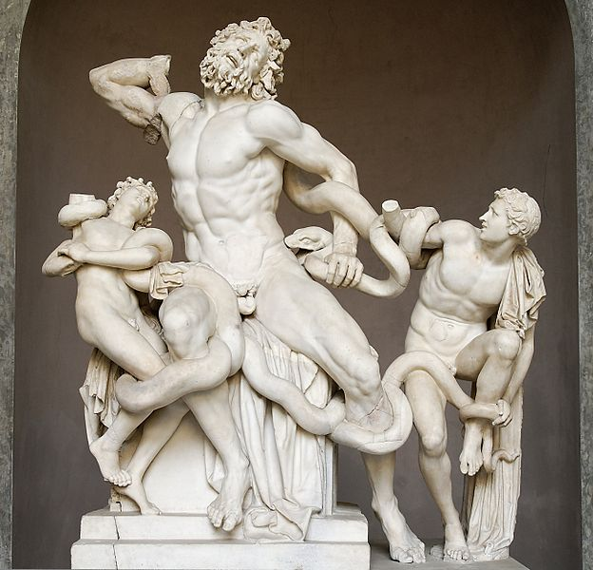
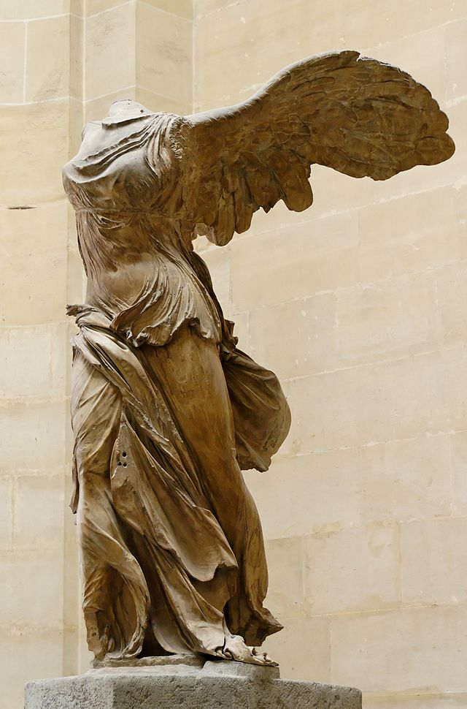
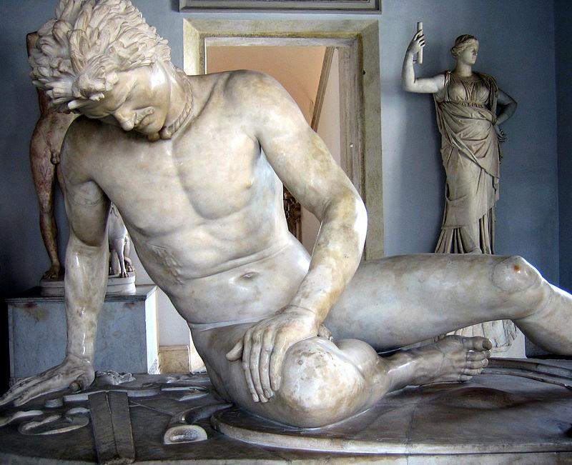
Hellenistic Style – Ancient Greek, (323 - 31 BC.)
12
16
10
Notes:
12 - Laocoön and his sons, also known as the Laocoön Group. Marble, copy after an Hellenistic original from ca. 200 BC. Found in the Baths of Trajan, 1506. - public domain - https://en.wikipedia.org/wiki/File:Laocoon_Pio-Clementino_Inv1059-1064-1067.jpg
16 - Winged Nike of Samothrace. Parian marble, ca. 190 BC? Found in Samothrace in 1863. – public domain - https://en.wikipedia.org/wiki/Winged_Victory_of_Samothrace#mediaviewer/File:Nike_of_Samothrake_Louvre_Ma2369_n4.jpg

Slide 21
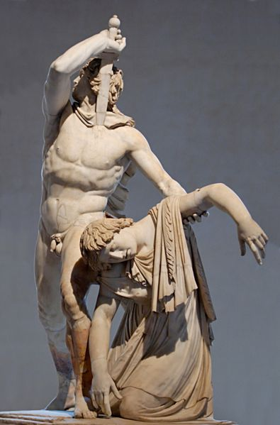
Hellenistic Style – Ancient Greek, (323 - 31 BC.)
Hellenistic Style – Ancient Greek, (323 - 31 BC.)
Complex, twisted poses
7
Forms break into viewer’s space
Wrapped figures in billowing fabric
Drama and emotion
Notes:
10 - The Dying Gaul, a Roman marble copy of a Hellenistic work of the late third century BC Capitoline Museums, Rome. - Photographer antmoose Anthony Majanlahti - https://commons.wikimedia.org/wiki/File:Dying_gaul.jpg
7 - So-called Ludovisi Gaul and his wife. Marble, Roman copy after an Hellenistic original from a monument built by Attalus I of Pergamon after his victory over Gauls, ca. 220 BC. – public domain - https://en.wikipedia.org/wiki/File:Ludovisi_Gaul_Altemps_Inv8608_n3.jpg

Slide 22
Contemplate then Collaborate
What major difference do you note between the Classical and the Hellenistic periods?

Slide 23
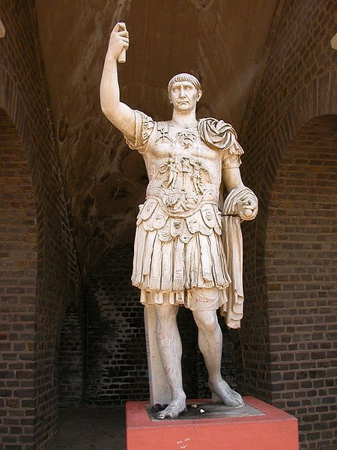
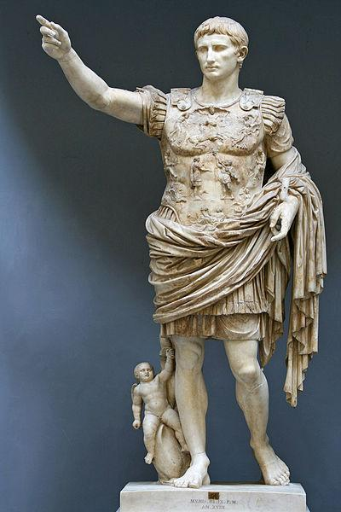
Ancient Roman Sculpture – Glorifying Emperors
13
17
Notes:
13 - Augustus of Prima Porta Date 1st century - Photographer Till Niermann - https://en.wikipedia.org/wiki/File:Statue-Augustus.jpg
17 - Trajan-Statue in Xanten, Gesamtbild. Photo by by Lutz Langer - https://commons.wikimedia.org/wiki/File:TrajanXanten.jpg

Slide 24
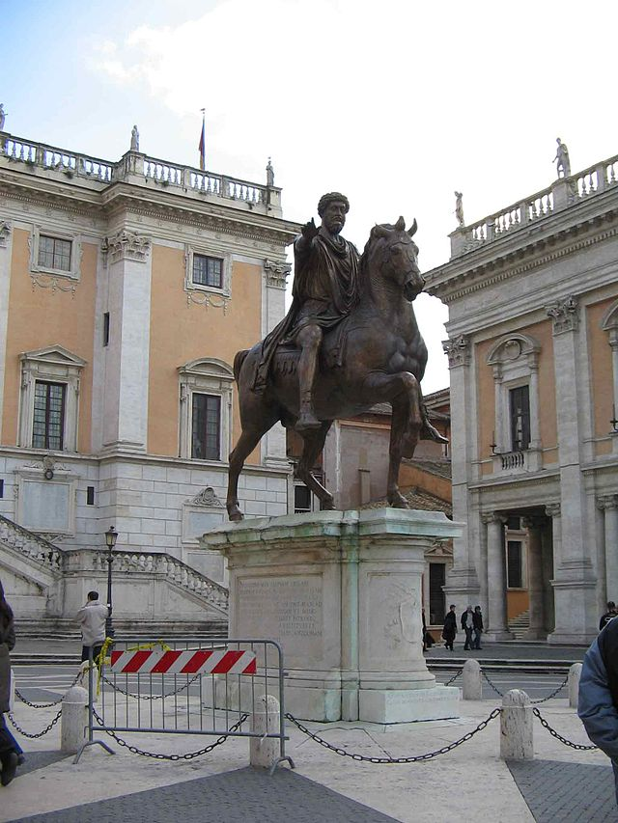
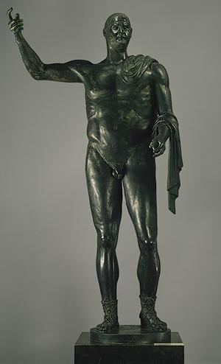
Ancient Roman Sculpture – Glorifying Emperors
5
6
Notes:
6 - Trebonianus Gallus, 251–53 a.d., Roman, Bronze, Met Museum - http://www.metmuseum.org/toah/works-of-art/05.30_05.47
5 – Marcus Aurelius – public domain - https://en.wikipedia.org/wiki/Equestrian_Statue_of_Marcus_Aurelius#mediaviewer/File:Marco-Aurelio.jpg

Slide 25
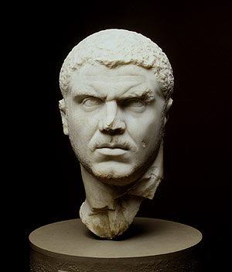
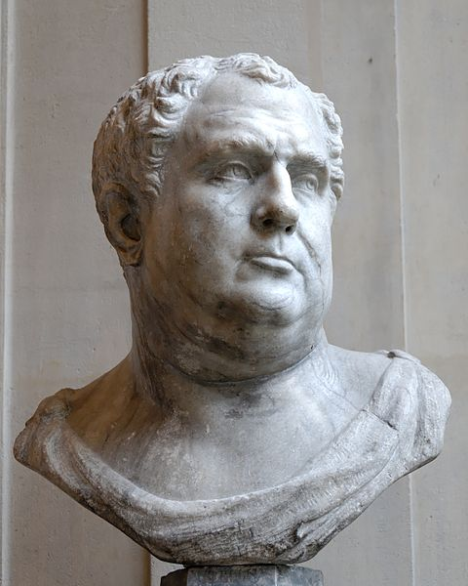
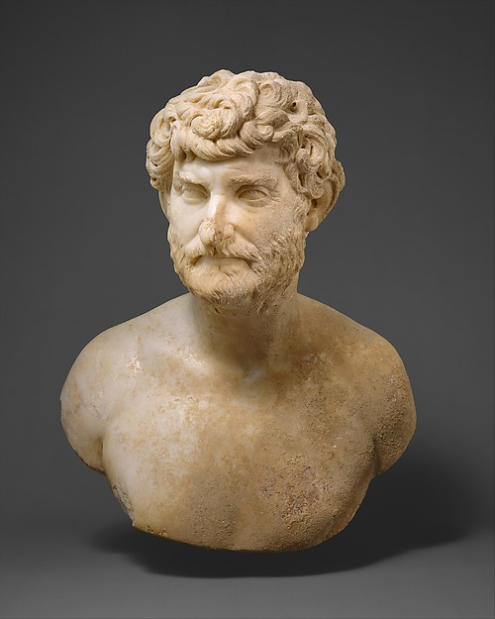
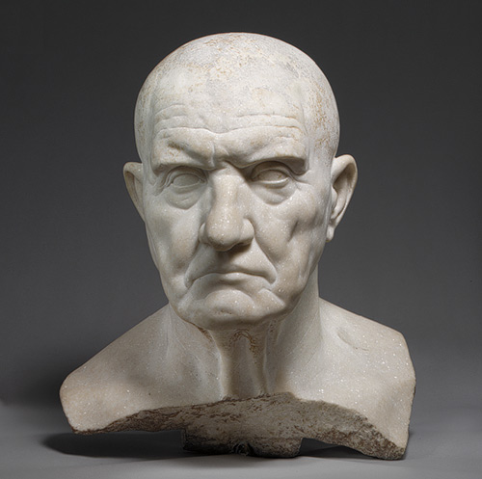
Ancient Roman Sculpture – Realism
11
18
1
3
Notes:
1 - Marble bust of a bearded man, Date: ca. A.D. 150–175, Culture: Roman, Met Museum - http://www.metmuseum.org/collection/the-collection-online/search/256911
3 -Portrait bust of a man, 1st century b.c.; Republican, Roman, Met Museum - http://www.metmuseum.org/toah/works-of-art/12.233
18 - Portrait head of Emperor Marcus Aurelius Antoninus (called Caracalla), ca. 217–230; Late Severan, Roman, Marble; H. 14 1/4 in. (36.2 cm) – Met Museum - http://www.metmuseum.org/toah/works-of-art/40.11.1a
11 - Male bust of the Pseudo-Vitellius type. Grey veined marble, Italian artwork of the first half of the 16th century, modern copy of an antique head of the Hadrianic era in the Grimani Collection in Venice, once thought to represent the emperor Vitellius. Photo by Jastrow (2008) Marie-Lan Nguyenhttp://commons.wikimedia.org/wiki/File:Pseudo-Vitellius_Louvre_MR684.jpg

Slide 26
Three Types of Ancient Roman Sculpture
1
2
3
Imperial Portrait Sculpture
Copies of Greek Originals
Portraits of Private Citizens
Propaganda for victorious and powerful Roman Emperor
Same characteristics of Classical style
Realistic detail and individualized features
Individualized features (we can tell who is who)
Making marble versions of Greek bronzes
Shows age and “imperfections”
But made more beautiful with idealized proportions, youth, and fitness
Considered “Roman copies of Greek Originals” instead of Roman art
“Warts and all”

Slide 27
Thought Greek and Roman statues didn’t have color?

Slide 29
Tell whether the following statues are Greek (which era: Archaic, Classical, or Hellenistic) or Roman. Then tell HOW YOU KNOW.

Slide 30
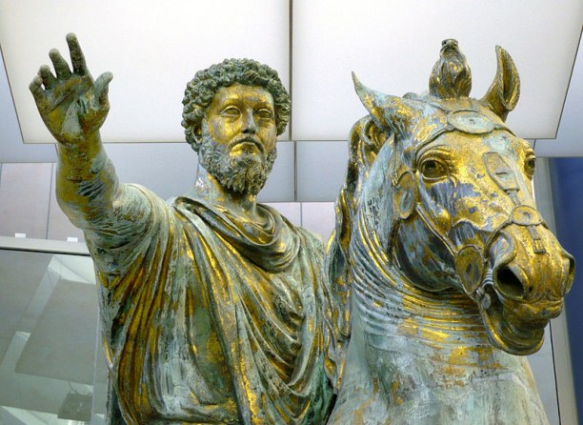

Slide 31
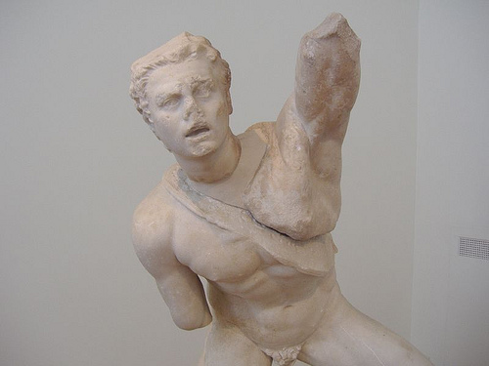

Slide 32
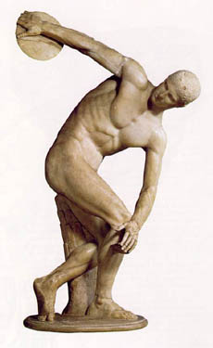

Slide 33
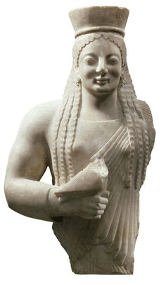

Slide 34
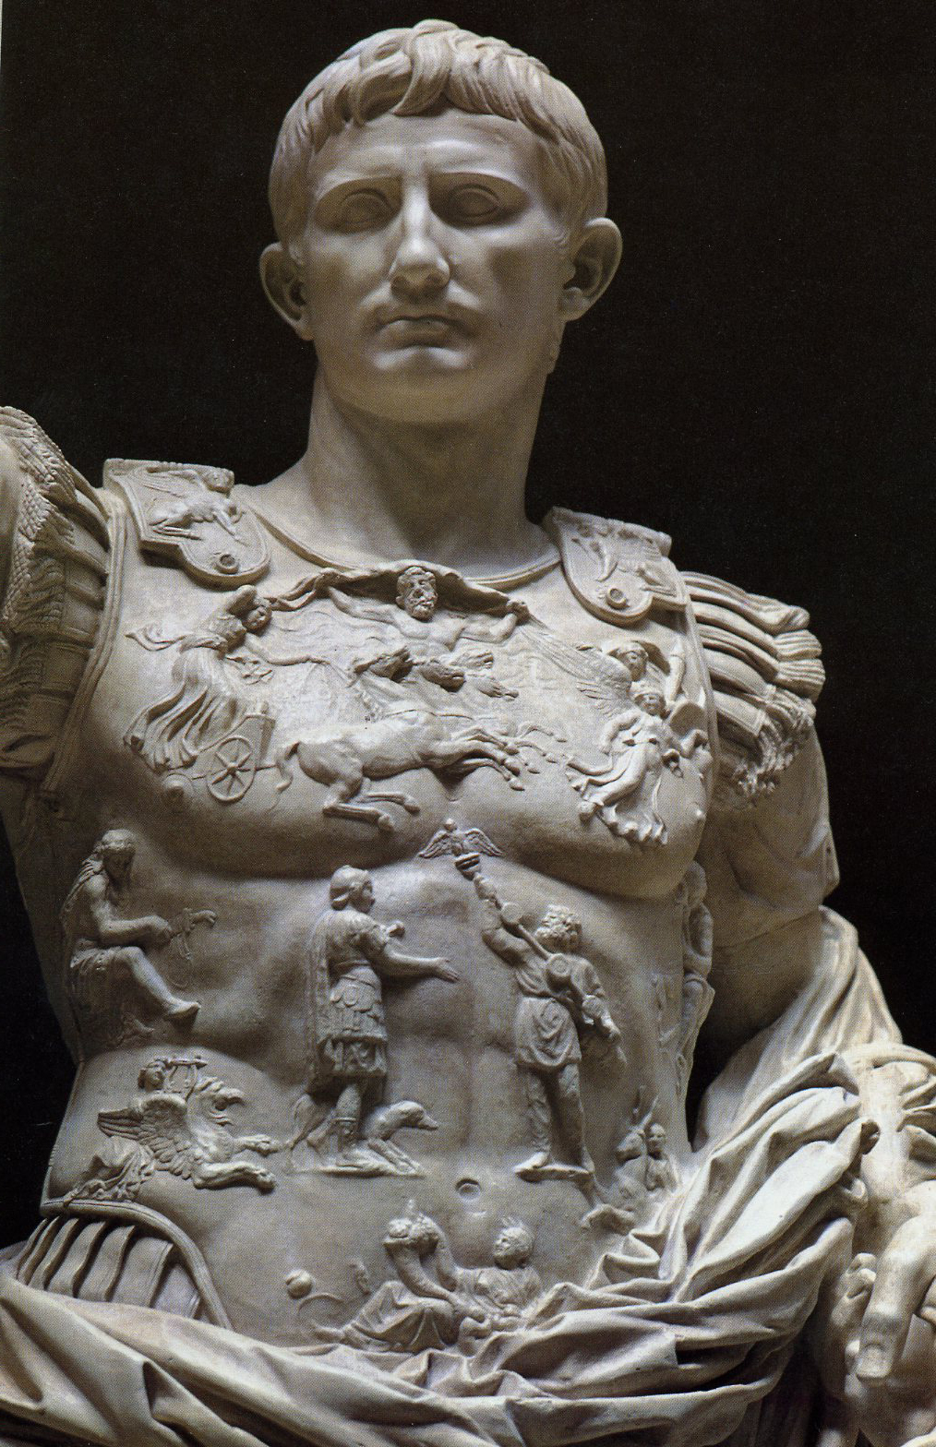

Slide 35
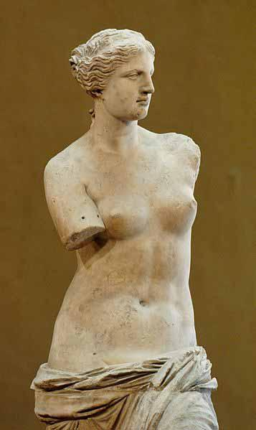

Slide 36
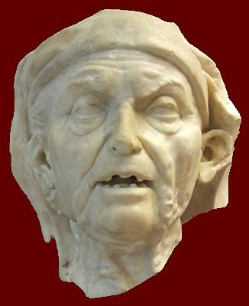

Slide 37
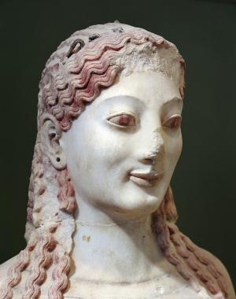

Slide 38
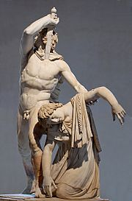

Slide 39
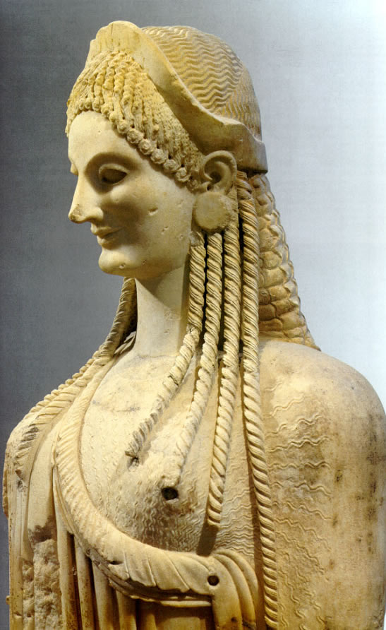

Slide 40
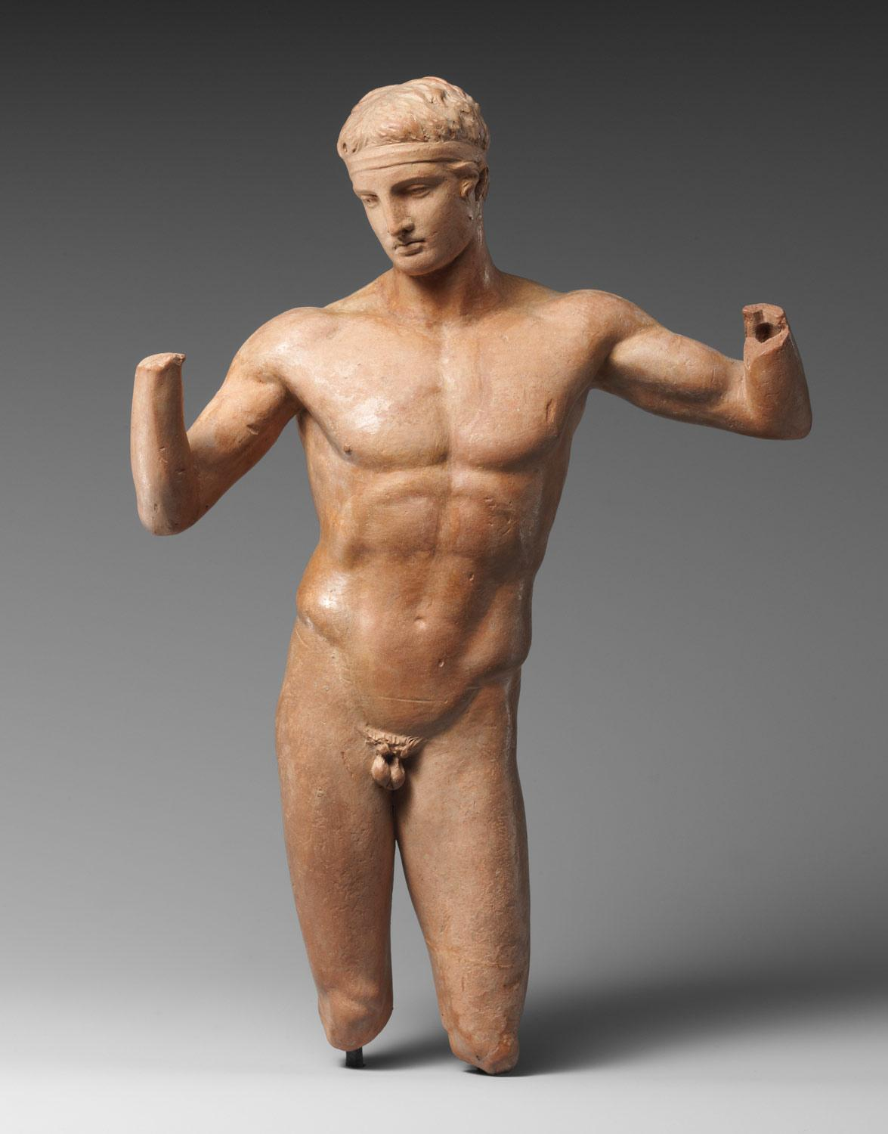

Slide 41
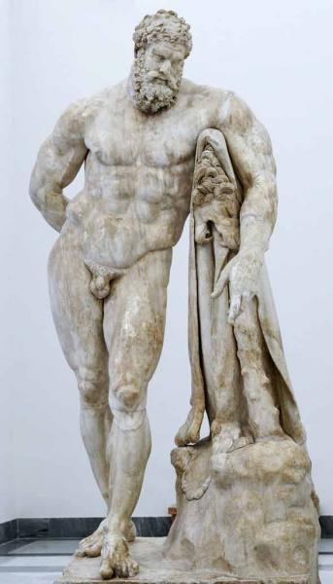

Slide 42
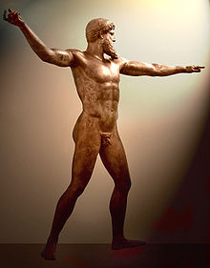

Slide 43
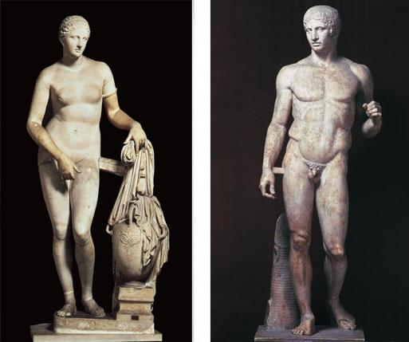

Slide 44
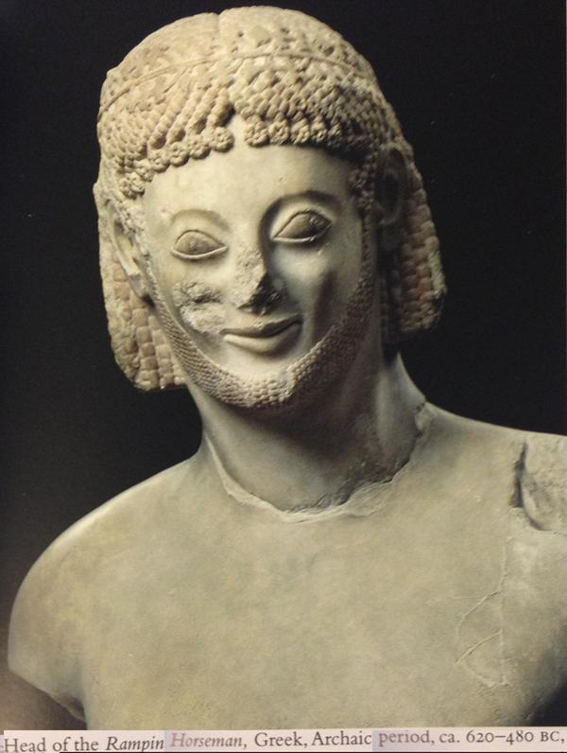

Slide 45
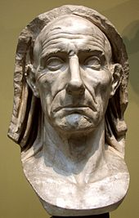

Slide 46
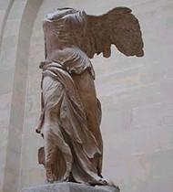

Slide 47
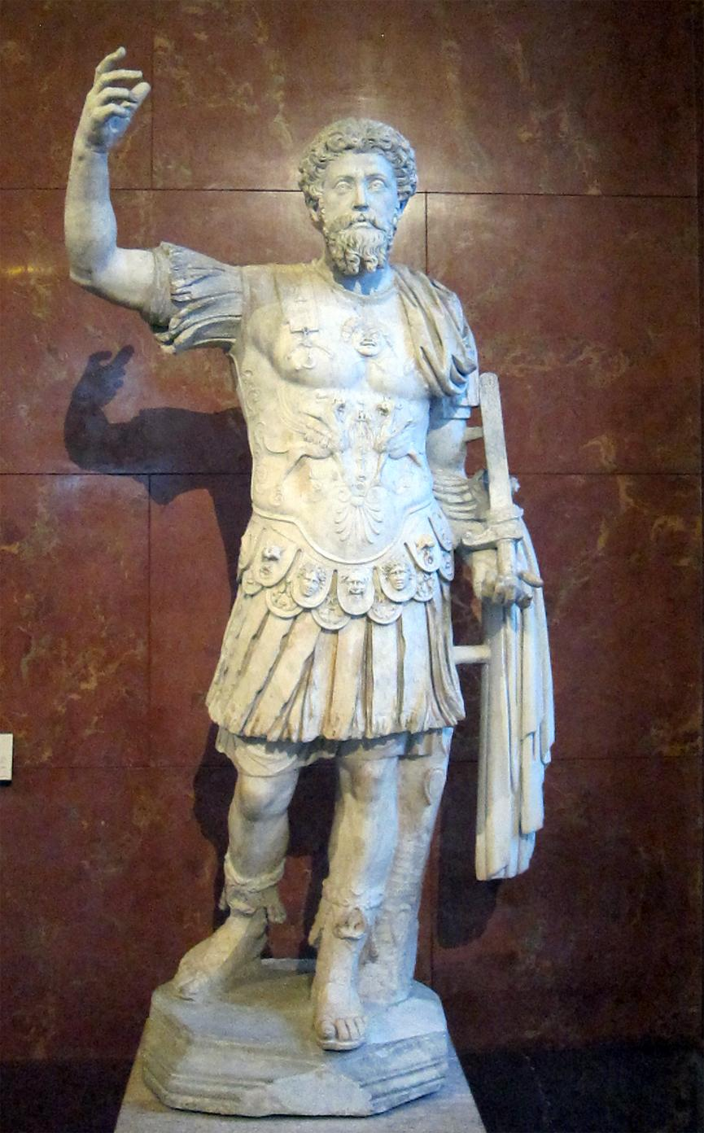

Slide 48
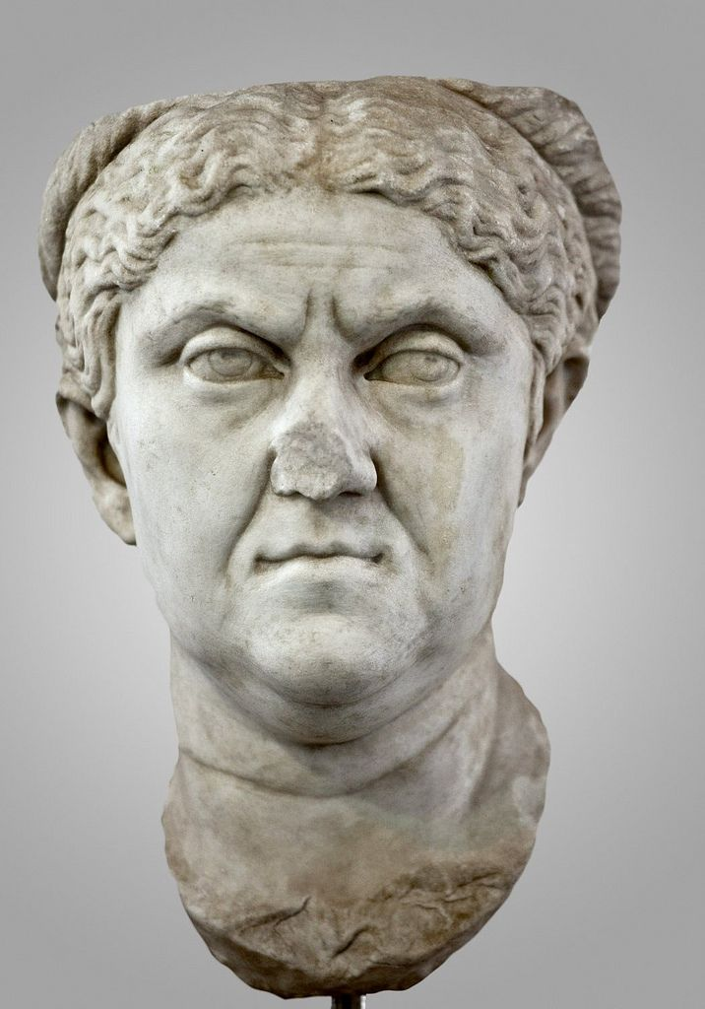

Slide 49
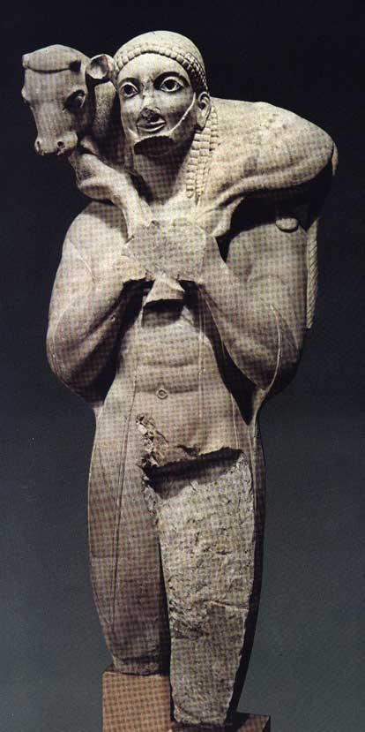

Slide 50
Ideal Greek Proportions
http://www.fitness.com/tools/greek_proportions/

