Slide 1
Introduction to The Odyssey

Slide 2
Homer
No one knows for sure who Homer was.
Later Greeks believed he was a blind minstrel, or singer, from the island of Chios.
One scholar suggests Homer was a woman because home and hearth played such an important role in his stories.
Some scholars think there were two Homers. Others think he was just a legend.

Slide 3
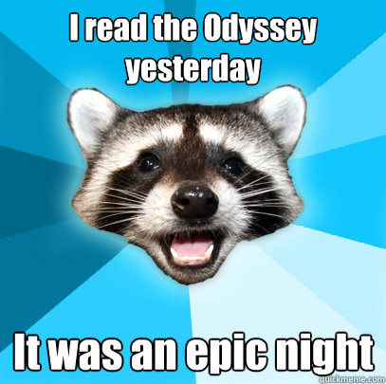
The Epic Poem
The Odyssey, like other epic poems, begins in the middle of the action (in medias res).

Slide 4
Odysseus’ Journey
Odysseus is not a typical epic hero. He is faced with:
difficult choices
post-war disillusionment
disrespect from the people of his homeland
Before the Trojan War, Odysseus:
married the beautiful and faithful Penelope
had one son named Telemachus

Slide 5
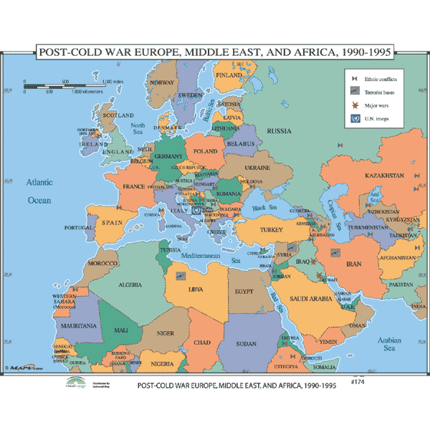
The Trojan war
War between
Troy and Mycenean
Greece.
Lasted 10 years.

Slide 6
How did it start?
The goddess Eris was not invited to a wedding, so she became upset and decided to throw a golden apple into the party. On the apple, there was a note that read, “for the fairest.” Because of the note on the apple, every goddess at the wedding claimed it was for her. The final decision of who the apple belonged to came down to Hera, Aphrodite, and Athena.

Slide 7
How did it start? Continued.
The person deciding whom the apple belonged to was Paris (his father was the king of Troy), so each of the three goddesses bribed him to be chosen as the “fairest.”
Aphrodite promised Paris the most beautiful woman in the world, so naturally, he chose her.
Because Aphrodite promised Paris the most beautiful woman in the world, Helen was the “most beautiful woman” who was promised.
The problem with this promise was that Helen was married to Menelaus, king of Sparta.

Slide 8
How did it start? Continued.
In order to claim his prize of the most beautiful woman (Helen), Paris traveled to Sparta, got Helen (with full cooperation from her and a portion of Menelaus’ fortune).
Menelaus was furious with this, so he gathered an army (under the comman of his brother Aganemnon) and traveled to Troy to overtake the city. Thus, the Trojan War began.

Slide 9
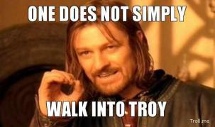
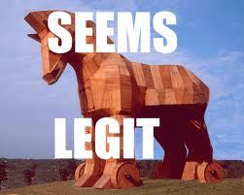
How did it end?
The Spartans (Greeks) built a hollow
wooden horse.
They then hid the army of men inside the horse, wheeled it to the city of Troy, and left it outside the Trojan gates.
The Trojans thought it was an offering to the gods and wheeled it into the city walls.
As the Trojans were celebrating the horse, the Spartans (Greeks) jumped out of the horse and attacked the city of Troy. At the end of the attack, the entire city of Troy was burned to the ground.

Slide 10
Human Characters
Odysseus: protagonist and epic hero.
Fought among the other Greek heroes at Troy and now struggles to return to his kingdom in Ithaca.
Husband of Queen Penelope and father of Prince Telemachus.
Athena favors him by sending divine aid.
Poseidon interrupts his journey every chance he gets.
Telemachus: Odysseus’s son.
An infant when Odysseus left for Troy, so he is about 20 years old at the beginning of the story.
He is a natural obstacle to the suitors desperately courting his mother.
Athena often assists him.
Agamemnon: Former king of Mycenae and brother of Menelaus.
Commander of the forces at Troy.
Odysseus encounters Agamemnon’s spirit in Hades.
Murdered by his wife and her lover upon his return from the war.
His son avenges his death.
Menelaus: King of Sparta, brother of Agamemnon, and husband of Helen.
He offers Telemachus assistance in his quest to find Odysseus.

Slide 11
Human Characters
Penelope: Wife of Odysseus and mother of Telemachus.
Deeply misses her husband (Odysseus).
She is easily excitable, but also clever and faithful to her husband despite his absence.
Helen: Wife of Menelaus and queen of Sparta.
Helen’s abduction from Sparta by the Trojans sparked the Trojan War.
Most beautiful woman in the world, but blamed for allowing her own abduction and starting war.
She offers Telemachus assistance in his quest to find his father.

Slide 12
Gods
The Olympians: Group of 12 gods who ruled after the overthrow of the Titans. All are related in some way. Named after their dwelling place→ Mount Olympus.
Zeus: King of gods and men.
Zeus is occasionally depicted as weighing men’s fates in his scales.
He sometimes helps Odysseus or permits Athena to do the same.
Cronus: Father of Zeus.
Hermes: Son of Zeus.
God of land travel and shepherds.
Hermes comes as a messenger to persuade Calypso let Odysseus go.
Hermes gives Odysseus advice on how to avoid danger from Circe and how to get his men back from her→ magical plant.
Apollo: The God of Archery is called on by Odysseus just before he shoots the bow on his (Apollo's) festival day.

Slide 13
Gods
Poseidon: God of the sea.
As the suitors are Odysseus’s mortal antagonists, Poseidon is his divine antagonist.
He despises Odysseus for blinding his son, the Cyclops Polyphemus, and constantly hampers his journey home.
Ironically, Poseidon is the patron of the seafaring Phaeacians, who ultimately help to return Odysseus to Ithaca.
Athena: Daughter of Zeus and goddess of wisdom, purposeful battle, and the womanly arts.
Athena assists Odysseus and Telemachus with divine powers throughout the epic, and she speaks up for them in the councils of the gods on Mount Olympus.
She often appears in disguise as Mentor, an old friend of Odysseus.
Persephone: Daughter of Zeus. Queen of the underworld.

Slide 14
Monsters and other mythical creatures
Polyphemus: Son of Poseidon. One of the Cyclopes (uncivilized one-eyed giants) whose island Odysseus comes to soon after leaving Troy.
Imprisons Odysseus and his crew and tries to eat them, but Odysseus blinds him through a clever ruse and manages to escape.
Calypso: The beautiful nymph who falls in love with Odysseus when he lands on her island-home.
Calypso holds him prisoner there for seven years until Hermes, the messenger god, persuades her to let him go.
Circe: The beautiful witch-goddess who transforms Odysseus’s crew into swine when he lands on her island.
With Hermes’ help, Odysseus resists Circe’s powers and then becomes her lover, living in luxury at her side for a year.

Slide 15
Monsters and other mythical creatures
Sirens: Dangerous and beautiful creatures, portrayed as femmes fatales who lured nearby sailors with their enchanting music and voices to shipwreck on the rocky coast of their island.
One of the dangers that Circe warns Odysseus of in the sea.

