Slide 1
The Four Steps of Art Criticism
Notes:
Lesson #1

Slide 3
Spend the next 10 minutes writing about this painting.
Get image from http://www.moma.org/learn/moma_learning/1168-2
Salvador Dalí, The Persistence of Memory, 1931
Notes:
Get image from http://www.moma.org/learn/moma_learning/1168-2 for your personal, classroom use.
Because this image copyright protected, you will need to pull them and copy them to your PowerPoint for your own personal educational use.
PC Instructions: Find the image using the link provided, right click the image, and then click “Copy.” On the PowerPoint page, right click, and select “Paste.” Resize as needed.

Slide 4
Discuss
What is the value of using the four steps of art
criticism when looking at art?
Description
Analysis
Interpretation
Evaluation
Notes:
This can be assigned in class or as a homework assignment.

Slide 5
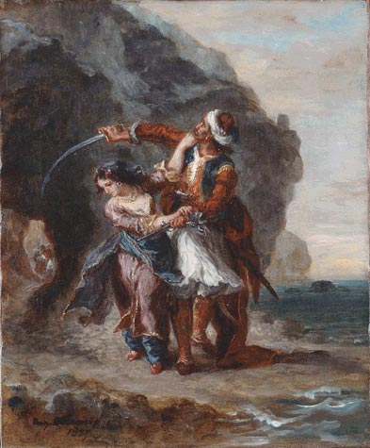
Description
Step One: Description
Objectively describe the contents and physical characteristics of the artwork
Do not interpret or discuss the elements and principles of art at this stage
Eugène Delacroix, Selim and Zuleika, 1857
Notes:
Have students do each step with this painting.

Slide 6
Description
Step Two: Analysis
Analyze the composition
Use the elements and principles to guide your looking
Elements of Art: Line, Shape, Color, Texture, Value, Space, Form
Principles of Design: Rhythm, Emphasis, Unity, Movement, Variety, Pattern, Proportion, Balance
Eugène Delacroix, Selim and Zuleika, 1857

Slide 7
Description
Step Three: Interpretation
What does the artwork mean? What is the artist trying to say?
Describe the story, meaning, message, idea, mood, and/or feelings in the artwork.
Historical and art historical relationships
Opinions backed up by evidence from the artwork.
Eugène Delacroix, Selim and Zuleika, 1857

Slide 8
Description
Step Four: Evaluation
Your judgment about the artwork
What is effective or ineffective in the work?
What is the artwork’s value?
Opinion supported by evidence in the artwork.
Eugène Delacroix, Selim and Zuleika, 1857

Slide 9
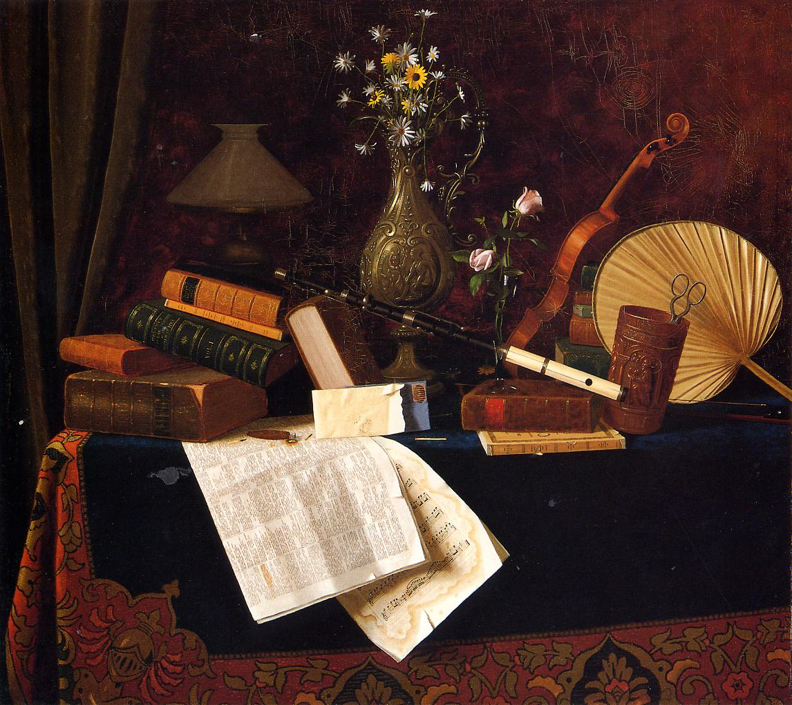
Review
There are many diagonal lines that move our eye through the painting.
Which step does the statement above fall in?
Description
Analysis
Interpretation
Evaluation
William Harnatt, Ease, 1887
Notes:
Analysis

Slide 10
Review
The contrast of the bright white paper in the center creates emphasis to that spot.
Which step does the statement above fall in?
Description
Analysis
Interpretation
Evaluation
William Harnatt, Ease, 1887
Notes:
Analysis

Slide 11
Review
The contents of the table suggest that the person who owns these objects enjoys music, reading, and is wealthy.
Which step does the statement above fall in?
Description
Analysis
Interpretation
Evaluation
William Harnatt, Ease, 1887
Notes:
Interpretation

Slide 12
Review
A tapestry-covered table holds musical instruments, sheet music, books, lamps, flowers, an envelope, a lit cigar, and a fan.
Which step does the statement above fall in?
Description
Analysis
Interpretation
Evaluation
William Harnatt, Ease, 1887
Notes:
Description

Slide 13
Review
The artist is skilled at creating a realistic effect. It looks like we could reach out and grab the items from the table!
Which step does the statement above fall in?
Description
Analysis
Interpretation
Evaluation
William Harnatt, Ease, 1887
Notes:
Evaluation

Slide 14
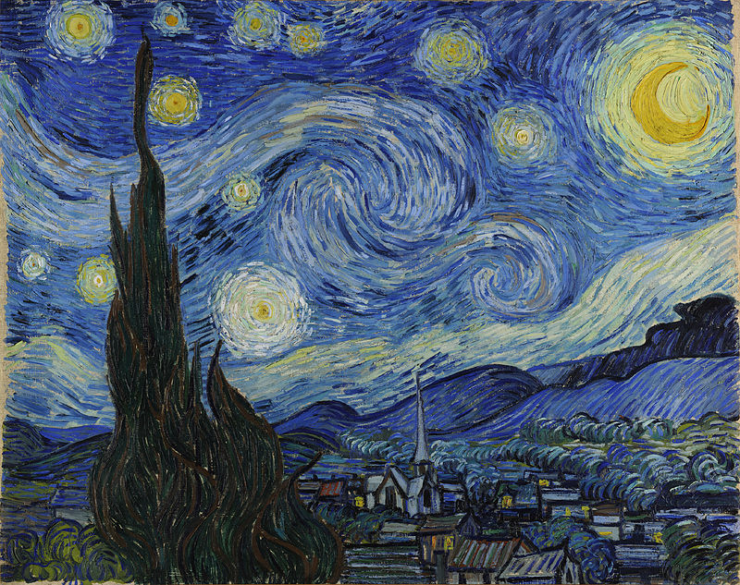
Review
The colors and lines of this artwork make me feel sad. The swirls remind me of the way my chest feels when I am anxious.
Which step does the statement above fall in?
Description
Analysis
Interpretation
Evaluation
Vincent van Gogh, The Starry Night, 1889
Notes:
Interpretation

Slide 15
Review
This is my favorite painting. It is so beautiful!
Which step does the statement above fall in?
Description
Analysis
Interpretation
Evaluation
Vincent van Gogh, The Starry Night, 1889
Notes:
Evaluation

Slide 16
Review
The lines flow up the Cyprus tree through the swirls in the sky then back down to the mountains which then return to the Cyprus tree.
Which step does the statement above fall in?
Description
Analysis
Interpretation
Evaluation
Vincent van Gogh, The Starry Night, 1889
Notes:
Analysis

Slide 17
Review
I want to buy a poster of this and hang it on my wall.
Which step does the statement above fall in?
Description
Analysis
Interpretation
Evaluation
Vincent van Gogh, The Starry Night, 1889
Notes:
Evaluation

Slide 18
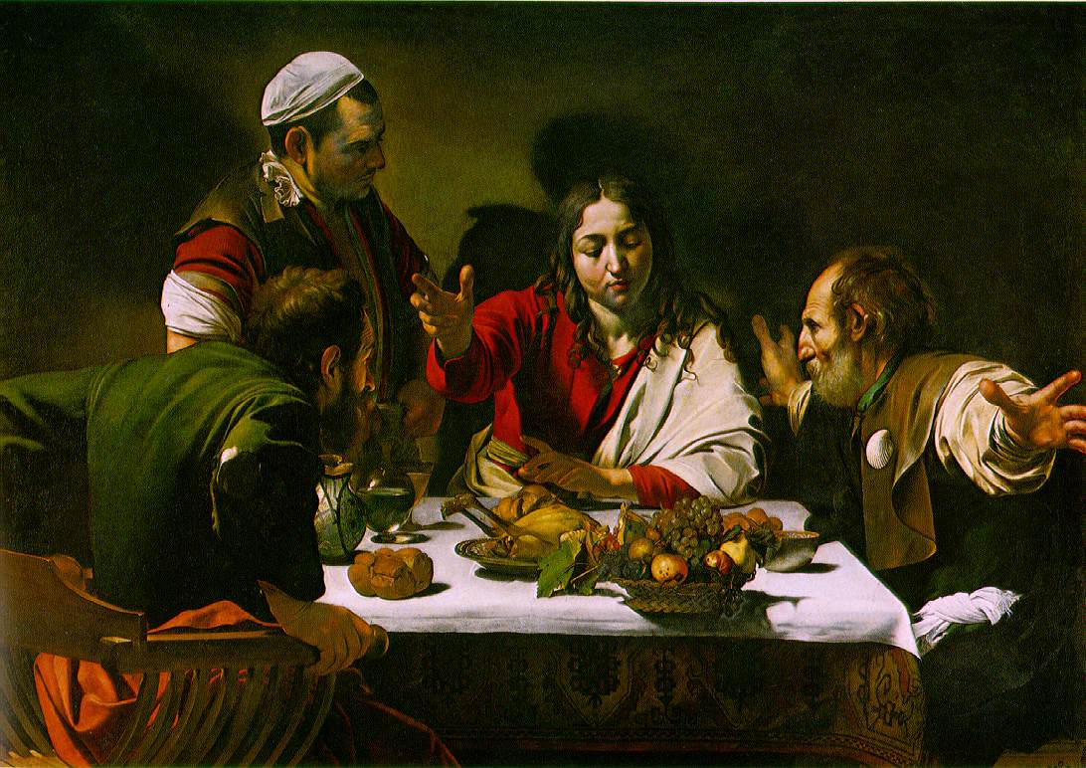
Review
There are 4 guys sitting around a table. They are gesturing with their hands. One guy is about to stand up.
Which step does the statement above fall in?
Description
Analysis
Interpretation
Evaluation
Caravaggio, Supper at Emmaus, 1601
Notes:
Description

Slide 19
Review
I can tell this was painted in the Baroque time period because of the light, lines, and scruffy people.
Which step does the statement above fall in?
Description
Analysis
Interpretation
Evaluation
Caravaggio, Supper at Emmaus, 1601
Notes:
Interpretation

Slide 20
Review
The guys are disheveled looking. They have mismatched clothes, holes in their sleeves, and they are not clean-shaven.
Which step does the statement above fall in?
Description
Analysis
Interpretation
Evaluation
Caravaggio, Supper at Emmaus, 1601
Notes:
Description

Slide 21
Review
The artist used foreshortening to make it look like the limbs are coming out at us.
Which step does the statement above fall in?
Description
Analysis
Interpretation
Evaluation
Caravaggio, Supper at Emmaus, 1601
Notes:
Analysis

Slide 22
Review
The composition is closed-in and intimate. The dramatic lighting pulls us in even more.
Which step does the statement above fall in?
Description
Analysis
Interpretation
Evaluation
Caravaggio, Supper at Emmaus, 1601
Notes:
Analysis

Slide 23
Practice
Go back to your writing from the beginning of class about Dali’s Persistence of Memory.
Mark each statement you wrote about the painting with one of the following notations.
D for Description
A for Analysis
I for Interpretation
E for Evaluation

Slide 24
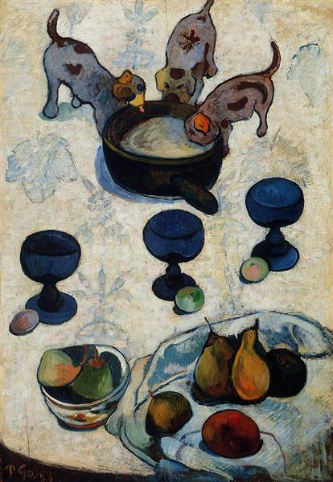
Art Criticism Quiz
Look at this
artwork and do
the activity on
your paper.
Paul Gauguin, Still Life with Three Puppies, 1888

Slide 25
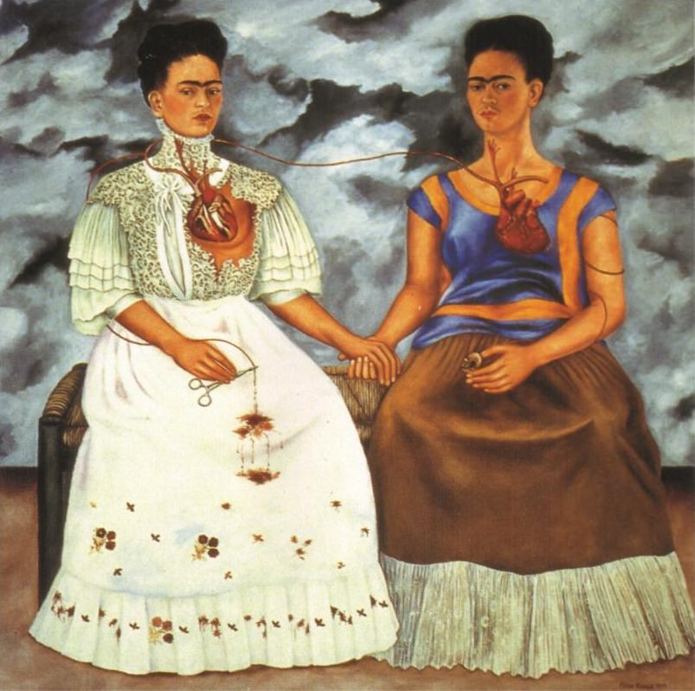
Frida Kahlo, Two Fridas, 1939

Slide 27
Lawrence Beall Smith, Don’t Let That Shadow Touch Them, 1942

Slide 28
Sandy Skoglund, Revenge of the Goldfish, 1981

Slide 29
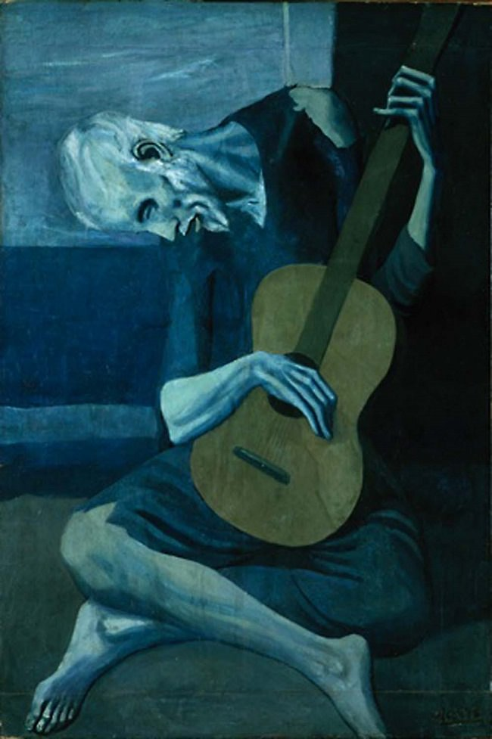
Pablo Picasso, The Old Guitarist, 1904

Slide 30
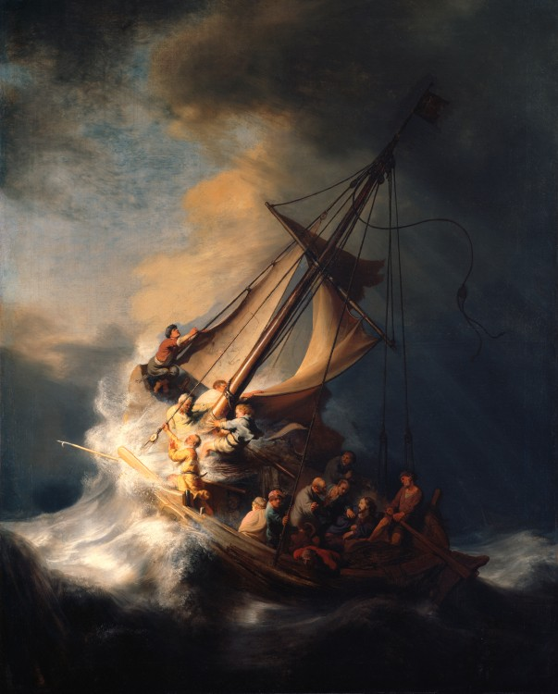
Rembrandt, The Storm on the Sea of Galilee, 1633

Slide 31
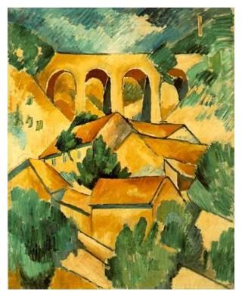
Viaduct At L'Estaque
Georges Braque

Slide 32
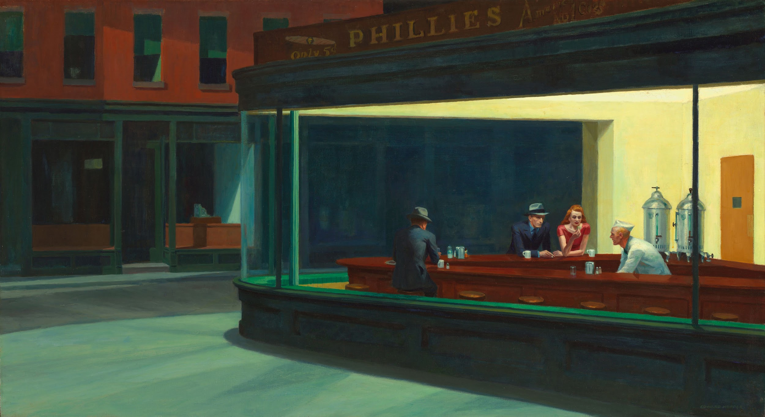
Nighthawks Edward Hopper

